Slide 1
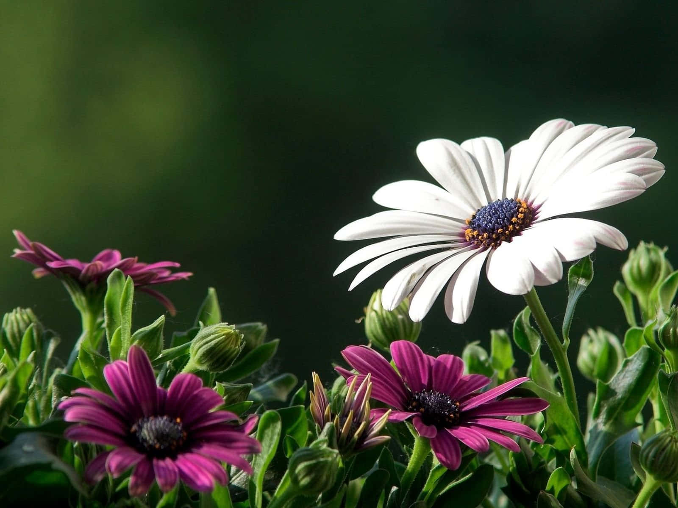
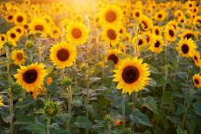
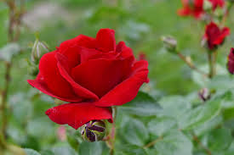
FLOWERS AT JDMC

Slide 2
SCIENTIFIC NAME Barbeton Daisy COMMON NAME Gerbera Jamesonii
INTRESTING FACTS
The first scientific description of a gerebera was made by J.D.HOOKER in Curtis botanical magazine in1889 when he described gerebera jamesonii , a south African species also known as Transvaal daisy or Barberton daisy. Gerbera is also commonly known as the African daisy.

Slide 3
SCIENTIFIC NAME Gazania Rigens COMMON NAME treasure flowers
INTRESTING FACTS
A typical daisy like flower up to about 10 cm across , they are commonly banded with a dark zone around the central disc. Some times they have linear petals...

Slide 4
SCIENTIFIC NAME KALANCHOE BLOSSFEDIANA COMMON NAME Christmas kalanchoe, flaming katy
INTRESTING FACTS
The most recognizable is kalanchoe blossfeldiana , usually known simple as kalanchoe

Slide 5
SCIENTIFIC NAME surfinia COMMON NAME Petunia
INTERESTING FACTS
Surfnia summer double salmon petunia hybrid. Petunia surfinia trailing red – petunia hybrid. Proven selection annuals.

Slide 6
SCIENTIFIC NAME Antirninom COMMON NAME Snapdragon
INTERESTING FACTS
Antirhinum commonly called snapdragon , is an old dragon favourites that, in optimum cool summer growing conditions , will flower well from spring too.

Slide 7
SCIENTIFIC NAME lobularia maritima COMMON NAME sweet alyssum
INTERESTING FACTS
Lobularia maritima is a species of low- growing plant in family Brassicaceae. Its common name is sweet alyssum , also commonly referred to as just alyssum.

Slide 8
SCIENTIFIC NAME begonia x semperfiorens COMMON NAME begonia fibrous
INTERESTING FACTS
Fibrous begonias are a diverse group known for their colorful flowers , compact shape and rounded green, bronze or variegated leaves.

Slide 9
SCIENTIFIC NAME rosa rubiginosa COMMON NAME Hybrid tea rose
INTERESTING FACTS
Hybrid tea roses (Rosa x hybrida) are the product of a cross between hybrid perpetual roses and old-fashioned tea roses. They are set apart by their large, high buds and tall, straight stems. The hybrid tea rose's long, pointed buds open by slowly unfurling.
From the JDMC Rose Garden , clicked by
DR. Namita Sethi , JDMC
SOURCE – WIKIPEDIA.ORG

Slide 10
SCIENTIFIC NAME rosa europeana
COMMON NAME
Floribunda
Floribunda, latin for many flowering, is a modern group of garden roses developed by crossing hybrid teas with polyantha roses. It is smaller and bushier than hybrid teas.
Clicked by Namita Sethi from the JDMC Rose Garden
Source wiki and better homes and gardens

Slide 11
SCIENTIFIC NAME rosa hybrida COMMON NAME Hybrid tea rose in multi colour
INTERESTING FACTS
One bush of roses with blooms in 2 colours :orange and pink, with the centre colour being different from the border colour
From the JDMC Rose garden
DR. Namita Sethi , JDMC
SOURCE – WIKIPEDIA.ORG

Slide 12
SCIENTIFIC NAME rosa chinensis minima COMMON NAME miniflora
INTERESTING FACTS
Miniature rose bushes can be 10 to 24 inches (25-61 cm.) in height and their blooms are 1 ½ inches (4 cm.) or less across in size. Miniflora rose bushes are somewhat larger in plant and bloom size. The average miniflora rose bush size is 2 ½ to 4 ½ feet (76 cm. to 1 m.) tall and can be within that range for plant width as well. The miniflora class was developed for those rose bushes that grow too large in bush or bloom size to be classified as miniatures, yet they are still smaller in bloom size than the floribundas, grandifloras, and hybrid teas.
From the JDMC Rose Garden , clicked by
DR. Namita Sethi , JDMC
SOURCE – gardening khnowhow.com

Slide 13
SCIENTIFIC NAME rosa chinensis minima COMMON NAME miniflora
INTERESTING FACTS
Miniature rose bushes can be 10 to 24 inches (25-61 cm.) in height and their blooms are 1 ½ inches (4 cm.) or less across in size. Miniflora rose bushes are somewhat larger in plant and bloom size. The average miniflora rose bush size is 2 ½ to 4 ½ feet (76 cm. to 1 m.) tall and can be within that range for plant width as well. The miniflora class was developed for those rose bushes that grow too large in bush or bloom size to be classified as miniatures, yet they are still smaller in bloom size than the floribundas, grandifloras, and hybrid teas.
From the JDMC Rose Garden , clicked by
DR. Namita Sethi , JDMC
SOURCE – gardening knowhow.com

Slide 14
SCIENTIFIC NAME Celendula COMMON NAME Common Marigold
INTERESTING FACTS
Celendula officinalis , the pot marigold, common marigold, ruddles is flowering plant in the daisy family . It is probably native to southern Europe and it may possibly be of garden origin.

Slide 15
SCIENTIFIC NAME rosa gallica COMMON NAME french rose
INTERESTING FACTS
Rosa gallica or french rose is a species of flowering plant in the rose family native to southern and central Europe eastwards to turkey. It is a parents of several cultivars..

Slide 16
SCIENTIFIC NAME POAEONIA SUFFRUTICOSA COMMON NAME moutan peony
INTERESTING FACTS
Poaeonia suffruticosa is a name used for group of cultivars of tree peonies that are the result of hybridisation with species exclusively belonging to the subsection vaginatae It highly revered in Chinese culture

Slide 17
SCIENTIFIC NAME rosa chinese COMMON NAME china rose
INTERESTING FACTS
Rosa chinensis ( chinese , pinyin ) is known commonly as the china rose, chinese rose or etc..

Slide 18
SCIENTIFIC NAME hybrid tea rose COMMON NAME bush rose
INTERESTING FACTS
You can propogate hybrid tea roses using cutting or planting seeds. Prune and deadhead..

Slide 19
SCIENTIFIC NAME coleostephus myconis COMMON NAME corn marigold
INTERESTING FACTS
Coleostephus myconis known as the corn marigold s an annual herbaceous plant belonging to the genus coleostephus of the family..

Slide 20
SCIENTIFIC NAME viola tricolor vsr. hortensis COMMON NAME pansy
INTERESTING FACTS
The garden pansy is a type of large flowering hybrid plant cultivated as agarden flower. It is derived by hybridization from several speciesin the section melanium.

Slide 21
SCIENTIFIC NAME Dahlia imperialis COMMON NAME bell tree dahlia
INTERESTING FACTS
Dahlia imperialis or bell tree dahlia is a large flowering plants of the family asteraceace growing 8-10 meters tall.

Slide 22
SCIENTIFIC NAME impatients COMMON NAME bizzy lizzy
INTERESTING FACTS
Impatients walleriana commonly called impatients or bizzy lizzy is the most popular annual bedding plant in the U.S. today

Slide 23
SCIENTIFIC NAME BEGONIA SEMPERFLORENSCULTORUM COMMON NAME WAX BEGONIA
INTERESTING FACTS
Wax begonia is a compact , mounded , succulent and fibrous-rooted plant with fleshy stems and green to bronze leaves.

Slide 24
SCIENTIFIC NAME SALVIA FLOWER SEEDS COMMON NAME GREEN TEA SALVIA
INTERESTING FACTS
Salvia coccinea , the blood sage , scarlet sage, Texas sage tropical sage is a herbaceous perennial in the family.

Slide 25
SCIENTIFIC NAME CARNATION COMMON NAME DIANTHUS CARYOPHYLLUS
INTERESTING FACTS
Dianthus caryophyllus is scientific name is carnation also called grenadine or clove pink. Herbaceous plant of the pink or carnation to the Mediterranean area

Slide 26
SCIENTIFIC NAME PERIALLIS HYBRIDA COMMON NAME COMMON RAGWORT
INTERESTING FACTS
Pericallis hybrida known as cineraria florist cineraria or common in flowering plant in the family

Slide 27
SCIENTIFIC NAME CHRYSANTHEMUM GLABRIUSCULUM COMMON NAME CHRYSANTHEMUM WHITE GULDAVARI
INTERESTING FACTS
Chrysanthemums sometimes called mums or chrysanths are flowering plants of the genus chrysanthemum in the family Asteraceae.

Slide 28
SCIENTIFIC NAME COMBRETUM INDICUM COMMON NAME RANGOON CREEPER
INTERESTING FACTS
Native to India , philippines, and Malaysia. The plant can reach up to 8 mtrs. Flowers are fragrant and tubular and color varies from white to pink and red.

Slide 29
SCIENTIFIC NAME FABACEAE COMMON NAME BUTTERFLY PEA-WHITE
INTERESTING FACTS
Medicinal plant also known as butterfly pea. Roots are used in ayurveda medicines. The plants are natives to Indonesia and Malaysia

Slide 30
SCIENTIFIC NAME APCYNACEAE COMMON NAME OLEANDER
INTERESTING FACTS
Native of India Flowers glow in clusters at the end of each branch. Colors vary from yellow ,white etc. plants are untouched by cattle and goats due to its toxicity

Slide 31
SCIENTIFIC NAME STRELIZIACEAE COMMON NAME BIRD OF PARADISE
INTERESTING FACTS
Native to south Africa. A very popular arnamental plant whose flowers are long lasting and looks like bird’s head

Slide 32
SCIENTIFIC NAME RUBIACEAE COMMON NAME JUNGLE GERANIUM / FLAME OF WOODS
INTERESTING FACTS
Native to southern India and Srilanka. The roots are analgesic , diuretic and anticeptic. The flowers , leaves and stem are used in ayurveda medicine. Flowers are ornamental and used in Hindu worship

Slide 33
SCIENTIFIC NAME Bougainvillea glabra COMMON NAME bougainbel/paper flower
INTERESTING FACTS
Native of South america. The roots are analgesic , diuretic and anticeptic. The bracts can be white/red/mauve/purple or orange.

Slide 34
SCIENTIFIC NAME Nyctanthes arbor-tristis COMMON NAME Har shingar/shiuli/coral jasmine
INTERESTING FACTS
Native to southern Asia. The flowers, which have a pleasing fragrance, lose their brightness in day time and are often seen spread below the tree where they fall. Used as an offering to God/temples hence its name which means the ornament of Gods. Leaves are used in homeopathy and ayurveda to treat arthritis and sciatica. Also, antipyretic.

Slide 35
SCIENTIFIC NAME Euphorbia pulcherrima COMMON NAME Poinsettia (red)
INTERESTING FACTS
Native to Central America. Displays special kind of inflorescence called cyathia. It is of commercial importance as it is used for Christmas floral decorations. Bracts come in red, orange, green, ivory, pink and white.

Slide 36
SCIENTIFIC NAME Clarkia COMMON NAME Punchbowl godetia
INTERESTING FACTS
Native to western North America. Its found in coastal hills as well as mountains. Flowers are usually pink to pale purple with broad petals

Slide 37
SCIENTIFIC NAME Hydrangea Macrophylla COMMON NAME Big Leaf Hydrangea
INTERESTING FACTS
Native to Japan but widely cultivated, in many climates. Blooms can range from blue, red, pink and purple. Flowers are arranged in huge, ball shaped clusters.

Slide 38
SCIENTIFIC NAME Lathyrus oforatus COMMON NAME Sweet Pea
INTERESTING FACTS
Native to Sicily, southern Italy and Aegean islands. It is an annual climbing plant. Has a distinct fragrance.

Slide 39
SCIENTIFIC NAME Combretum indicum COMMON NAME Madhu malati/ Rangoon creeper
INTERESTING FACTS
Native to the Indian sub-continent, Malaysia and Phillipines. Can reach up to 8 metres tall. Flowers are tubular and scented, with the colour varying from white to red and pink. Anti-helminthic decoctions are made from its root, seed or fruit.

Slide 40
SCIENTIFIC NAME Callistemon viminalis COMMON NAME Cheel/Bottle brush
INTERESTING FACTS
Native of Australia. Flowers are in bright red spikes. Quick growing and distinctive in appearance.

Slide 41
SCIENTIFIC NAME Nerium oleander COMMON NAME Oleander
INTERESTING FACTS
Native of India. Floral clusters found at the end of each branch may be of any of the following colours: yellow, white, pink or red. Plants are left alone by cattle and goats due to their toxicity.

Slide 42
SCIENTIFIC NAME Primula COMMON NAME Primrose
INTERESTING FACTS
Native of western and southern Europe, North-west Africa and parts of South-west Asia. Flowers are pale yellow, white or pink. Butterflies and beetles flock to these flowers.

Slide 43
SCIENTIFIC NAME Bellis Peremnis COMMON NAME Daisy
INTERESTING FACTS
Young leaves of this plant can be eaten as a salad.Flowers, buds and petals are edible too and often used in sandwiches, soups and salads. Also used in teas and as a vitamin supplement. It has medicinal properties as well.

Slide 44
SCIENTIFIC NAME Hibiscus Rosa sinensis COMMON NAME Rosellea
INTERESTING FACTS
Native to warm temperate, sub-tropical and tropical regions, this flowering plant is found throughout the world. It spans over 300 species and is a multi-purpose plant, with various health benefits. It grows throughout the year. In Sanskrit it is known as japapati and is used for hair to promote growth and condition it.

Slide 45
SCIENTIFIC NAME Catharanthus roseus COMMON NAME Periwinkle/ sada bahaar
INTERESTING FACTS
Catharanthus or periwinkles are found in many shades of pink, red,lilac, white and purple. It is used for treating a host of health issues including diabetes, sore throat and is said to even reduce the risk of cancer.

Slide 46
SCIENTIFIC NAME Tropaeolum majus COMMON NAME Nasturtium
INTERESTING FACTS
Native to South and Central America, Nasturtium is used as a companion plant for biological pest-control and for attracting predatory insects. It has uses in herbal medicine for respiratory and urinary infections.

Slide 47
SCIENTIFIC NAME Lantana montevidensis COMMON NAME Lantana ( Florida red)
INTERESTING FACTS
Native to South America, the flowers come in a variety of colours including white, yellow, orange, lavender, pink, purple and combination colours. It is believed to have uses in tumours, skin itching, leprosy, rabies, chicken pox, asthma and ulcers.

